Slide 1
EE140: Introduction to Programming Concepts for Engineers
Lecture 2: Programming Basics and Variables

Slide 2
Programming Basics
We examine two fundamental aspects of programming: how to store data inside a program (Variables and Constants), and how to pass data to and from the outside world (Input/Output functions)
Variables
Constants
printf()
scanf()

Slide 3
Variables
Variables are used to store and manipulate data in a program.
Variables must be defined before they are used
the compiler is not psychic
Variable definition must include a name and a data type
name is how you refer to that variable in your program
data type tells the compiler how much memory to allocate for that variable, what operations apply to it, and so on.

Slide 4
Defining Variables
float Avogadros_Number;
int x;
char c;
int a, b, c;
float y23 = 75.6;
int Average = 0;

Slide 5
Variable Names
A variable’s name allows you to refer to that variable through the program.
must be unique (no confusion)
names may be any combination of letters a-z and A-Z, numbers 0-9, and the underline “_” character
case sensitive
Names, like comments, are a way to maintain intellectual control over the program.
use meaningful names like “UserAddress” or “taxes_total” that remind you what the data stored in that variable means in your program.

Slide 6
Variable Data Types
C supports many different data types.
char: a single character – in many senses, a single keyboard symbol.
char answer;
examples: A, $, g, *, (space)
int: an integer value. A number, positive or negative, with no decimal or fraction component
int sum = 0; // sum is initialized to o
examples: 0, 12, -2000
float: a floating point number (real number)
float width, length;
examples: 0.0, 3.14159, -1000.23, 6.022 x 10²³
More data types will be introduced later on

Slide 7
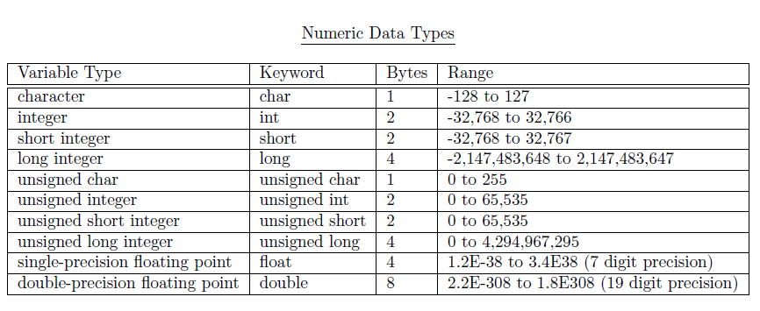
C Numeric Data Types and Properties
1 byte = 8 bits: 00000000 – 11111111
(2^8 values)

Slide 8
Constants
Constants are variables that cannot change value
Like variables, constants must be defined before they are used
the compiler is still not psychic
Constant definition must include a name and a data type
same deal as with variables.

Slide 9
Defining Constants
There are two ways to define constants
preprocessor constant
#define PI 3.14159
#define SIZE 85
constant variable
const float PI = 3.14159;
const int SIZE = 85;
Either way, constants in C code are usually all CAPS to aid programmers in recognizing them when in use

Slide 10
Constant Variables: why?
Why is it useful to declare constant variables?
Why not use a literal instead -- just put the value in the code directly?

Slide 11
I/O: the printf() function
Print a text message
printf (“Hello”);
Print the value of a variable
printf (“Sum is %d\n”, sum);
“Sum is %d\n” is a formatted string
%d: format indicator for int data type variables
When it is executed, %d will be replaced by the value of sum
Other format indicators will be introduced later on

Slide 12
I/O: the scanf() function
Input value of a variable from keyboard
scanf (“%d”, &integer1);
Two arguments
“%d”: is a formatted string
%d: format indicator for int data type variables
(other format indicators will be introduced later on)
&integer1
The value scanned (entered) is to be stored in the variable integer1
Don’t forget & sign before the name of the variable
When executed, the whole statement will wait for an integer value to be input from the keyboard

Slide 13
Example 1: Adding two integers
/*This program asks the user to enter two integers and prints out their sum */
#include <stdio.h>
int main(void)
{
int integer1; /* first number to be input by user */
int integer2; /* second number to be input by user */
int sum; /* variable in which sum will be stored */
printf( "Enter first integer\n" );
scanf( "%d", &integer1 ); /* read an integer */
printf( "Enter second integer\n" );
scanf( "%d", &integer2 ); /* read an integer */
sum = integer1 + integer2; /* assign total to sum */
printf( "Sum is %d\n", sum ); /* print sum */
return 0;
}

Slide 14
Example 2: Area of a Circle
/* This program asks user to enter the radius of a circle and then print out the area of the circle. */
#include<stdio.h>
#define PI 3.14159 /*set preprocessor constant PI*/
int main( void )
{
floatradius, area; //radius and area of a circle
printf("Input radius? ");
scanf("%f", &radius ); // input the radius
printf("radius entered is %f\n", radius);
/* not necessary, but good testing to make sure you have
read in the correct value of radius */
area = PI * radius * radius ; // calculate area
printf("Area = %f\n", area) ;// display area
return 0 ;
}

Slide 15
Debugging Two Ways
Debug means to fix problems (bugs) in programs.
Problems come in two types:
Syntax Errors
Logic Errors
The Compiler (GCC) is your main tool for solving syntax errors
The Debugger (GDB) is your main tool for solving logic errors

Slide 16
Ex 1: Debug using breakpoints
In the following program we will set a breakpoint in line 8 (the statement i=1;) and then single-step through the program.
#include <stdio.h>
int main()
{
int i;// variable i is uninitialized
int j=0; // variable j is initialized to 0
line 8 i=1;
i=2;
i=3;
i=4;
i=5;
j= i+1;
return 0;
}

Slide 17
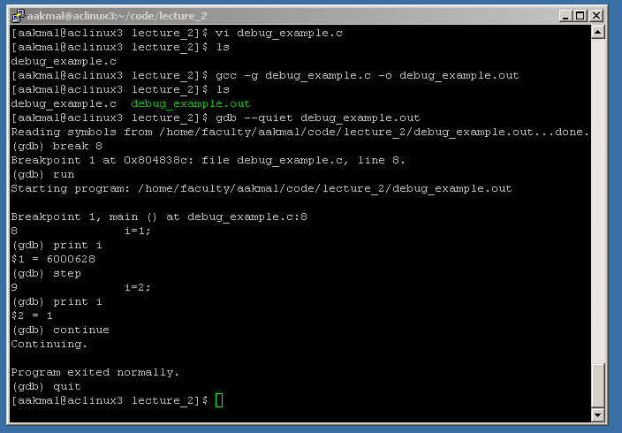
Ex1b: Debug using Breakpoints in gdb

Slide 18
Submitting your assignments
$> mkdir assignment_1 make a directory
$> cd assignment_1 move to directory
(put source and compiled code in this directory:
question1.c, question1.out, etc …)
$> cd .. move back up one directory
$> tar –czvf assignment_1.tar.gz assignment_1
create a compressed archive
$> cp assignment_1.tar.gz /home/faculty/dkuijt/dropbox/ee140
leave assignment in my dropbox

